Slide 1
OLTP Vs OLAP

Slide 2
OLTP (On Line Transaction Processing )
Operational system / transaction system
Uses RDBMS
Good for single source of data
Structured format
Data can be updated (volatile)
Limitations / challenges
Can’t have integrated data view
Can’t have uniform user interface
Can’t have sharing of data

Slide 3
OLAP (On Line Analytical Processing)
Uses Ware house
Assumes Read-only and non-volatile data
Data is presented in summary format
Can Handle Multiple data sources
RDBS
Twitter
Scientific Databases
Personal Databases
etc
Advantages
Integrated data view
Sharing the data
Uniform User Interface
Best for Decision Making

Slide 4
Data in Data Warehouse (OLAP)
RDBS has detailed data
Maintaining Huge data is costly
Solution → warehouse
Warehouse ::
Allows analysis of huge data
So, more data more value in terms of analysis and predictions
Presents data as summary

Slide 5
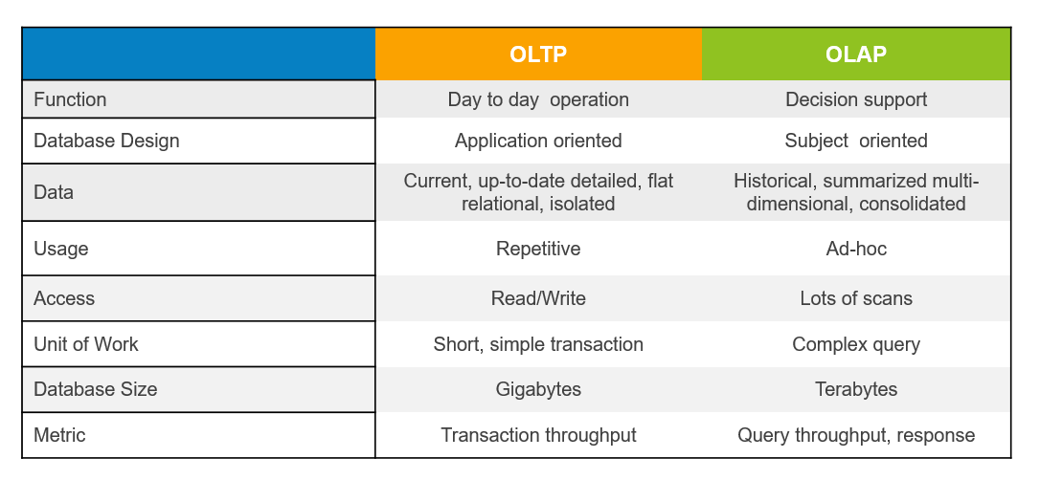

Slide 6
Which one to Choose ?
OLAP is not alternative to OLTP
Both have their own use

